Slide 1

COMPILER DESIGN

Slide 2





Communication medium / Interface - Importance
System Program:
Schemes for
Program development
Program execution
System Software:
Collection of all system programs in a whole single package.
System Software
=
Interface between user
& machine.
I
N
T
E
R
F
A
C
E
SYSTEM
SOFTWARE
Ma,
I’m
Hungry.!
Food’s
Ready
Dear.!

Slide 3









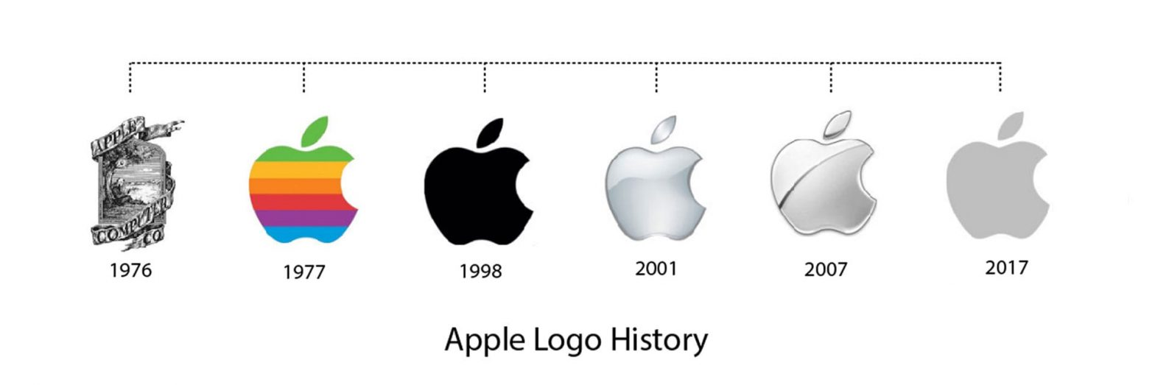







Application Software:
System Software:
Hardware:
User
Application
Software
System
Software
Hard
ware

Slide 4
USER
Collection of programs
that bridges the gap
between the computer
and the user.
Basic examples:
Utility software
System servers
Device drivers
Operating system
Windows / Graphical
user interface system
Translates the needs of
The user in a language
that computer understands.
SYSTEM SOFTWARE
Acts as an intermediary
between the user
and the machine.
COMPUTER
Software designed to
provide platform for
other software's.

Slide 5
Designed to control and coordinate the procedures and functions of computer hardware.
Enable functional interaction between hardware, software and the user.
System Software
Types
Operating system
Acts as interface between hardware, system programs
and user - windows
Device Driver
Device communication between OS and other programs – in-built drivers installed.
Firmware
Operational software embedded within memory chips – BIOS, UFEI – resides within devices
Translators
Intermediate programs to translate high level source code to machine language code
Utility software
Acts as interface between system and application software – maintenance tasks - Firewall

Slide 6



Semantic – rules
Semantic gap – difference in semantics of both domain
Software that bridges the semantic gap between the application domain and execution domain and helps in effective communication between both.
Developed and executed at execution domain
Application domain (like python code)
Language Processors
Develops code in programming lang.

Slide 7
Roles and responsibilities of a Language Processor
Source Program
(Eg. Python code,
C++ code..)
Language
Processor
Target Program
(Eg. Machine
executable code)
Input
Output
Source program is written in source language i.e., programming language.
Target program is of the target language form which should be understood by the machine.
In case of presence of error in source language code while executing it, language processor never takes it.
Basically, language processor translates normal programming code into code that can be read and understood by the machine.

Slide 8


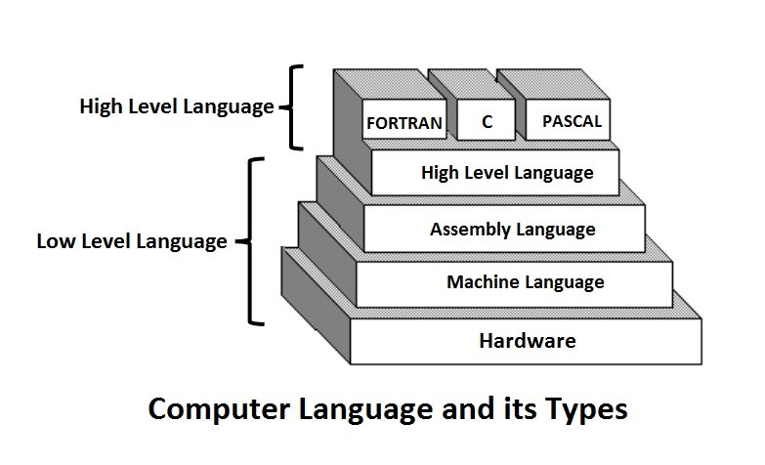
Low-level language
Types of languages
High-level language

Slide 9

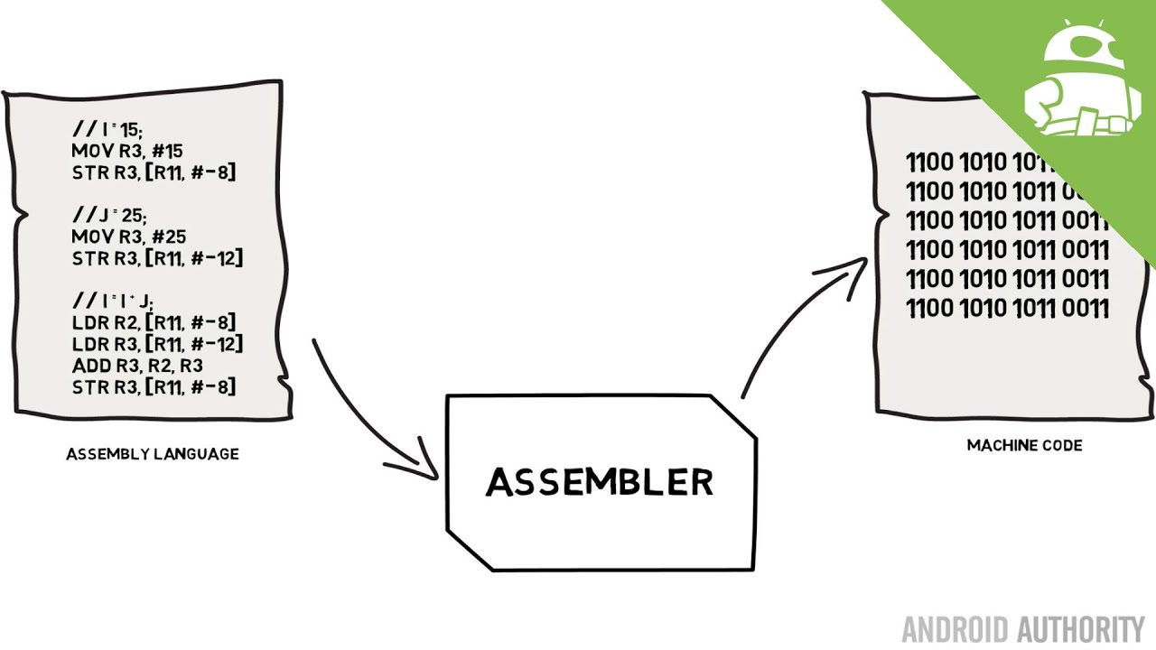
Low - Level Language
Hardware elements of the computer communicates with each other.
Numerical language (binary – 0’s and 1’s) intended to run as fast as possible.
Non portable.
Commands or functions in the language map closely to processor instructions.
Machine language
Types of low
level languages
Assembly language

Slide 10


Machine Language
Directly understood by computer hardware devices.
No need to translate.
Written as strings of zero’s and one’s.
Each instruction causes the CPU to perform a very specific task, such as a load, a store, a jump, or an arithmetic logic unit (ALU) operation.

Slide 11

2⁷
¹²⁸
2⁶
⁶⁴
2⁵
³²
2⁴
¹⁶
2³
⁸
2²
⁴
2¹
²
2⁰
¹
0 | 0 | 1 | 0 | 0 | 0 | 0 | 1
33
Other Eg.
0 | 0 | 1 | 0 | 0 | 0 | 1 | 1
35

Slide 12
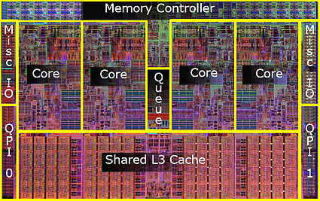
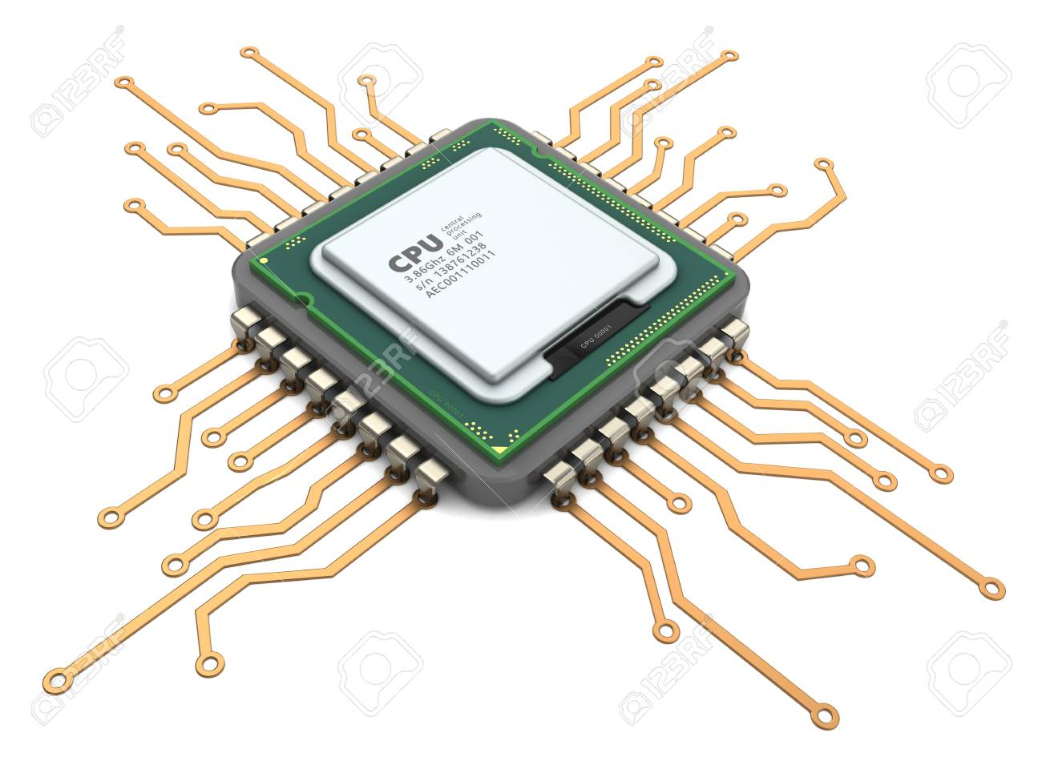
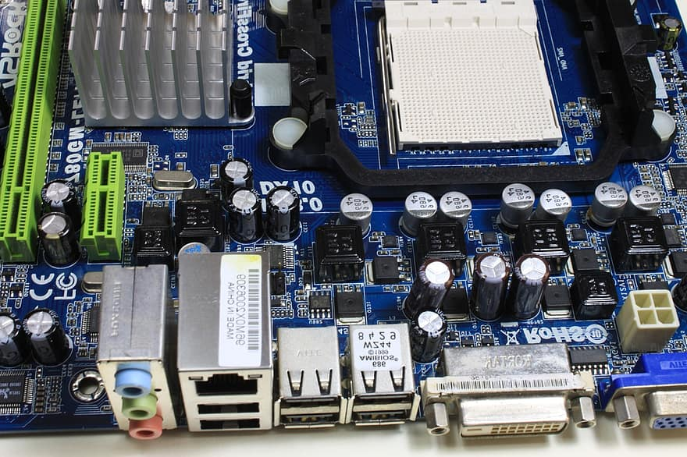

Slide 13
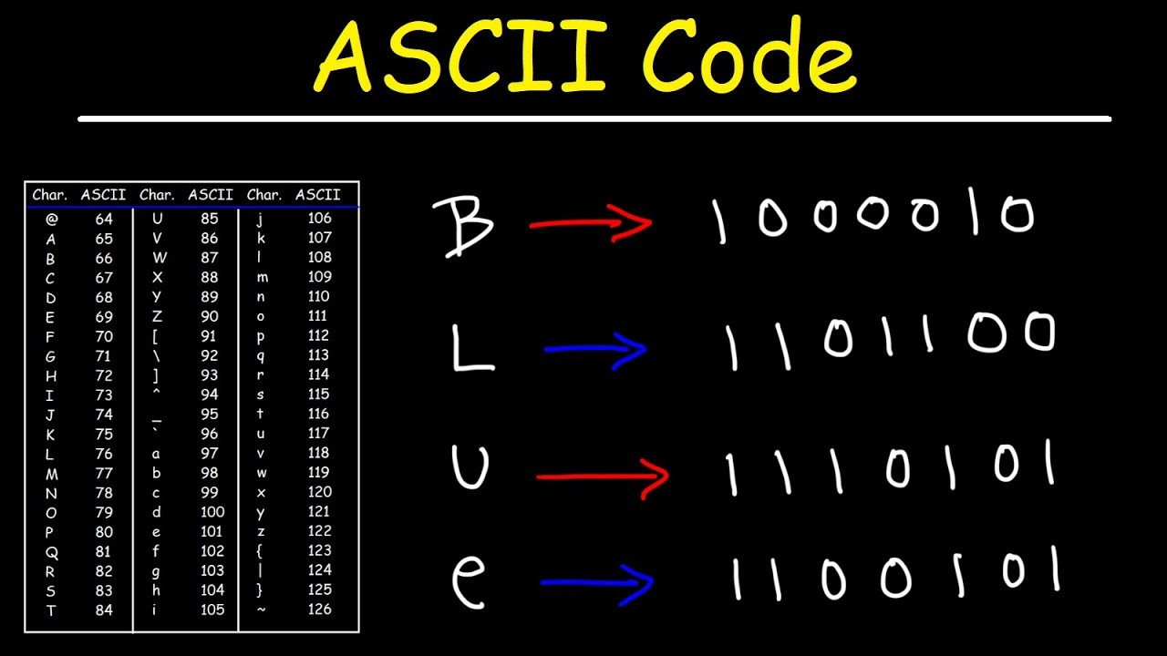

Slide 14
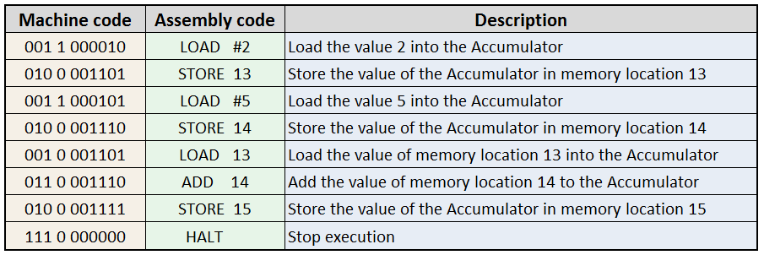
Assembly Language
Improve program structure and make machine language readable for human.
Consists of set of symbols and letters.
Translator is required to translate the assembly language to machine language for the machine to understand it.
Compared to machine code, its easier for humans to read and understand.
Compared to programming language, its difficult for humans to write code in it.

Slide 15
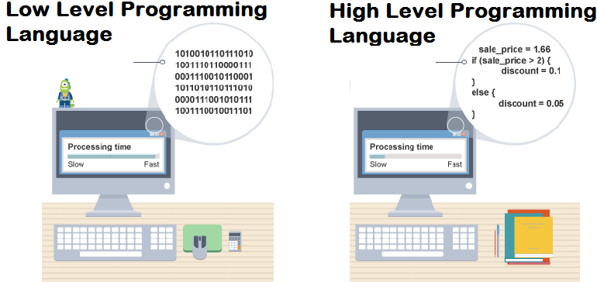
High Level Language
Programming language that uses English words and mathematical symbols like +,-,*,/ and many others in instructions.
Programming language = high level language
Closer to the logic of human language.
To learn normal language | To learn programming language
Vocabulary Grammar | Commands Syntax Logic

Slide 16
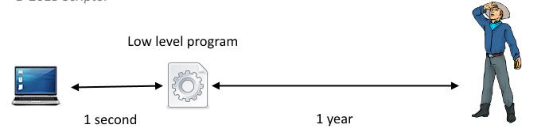
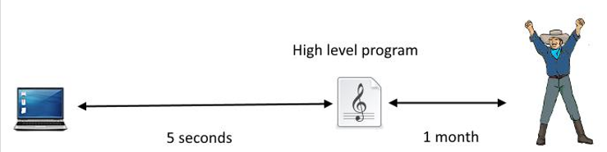
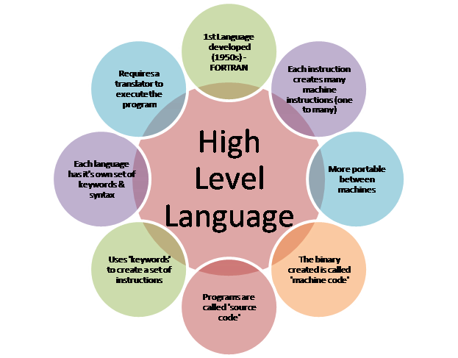
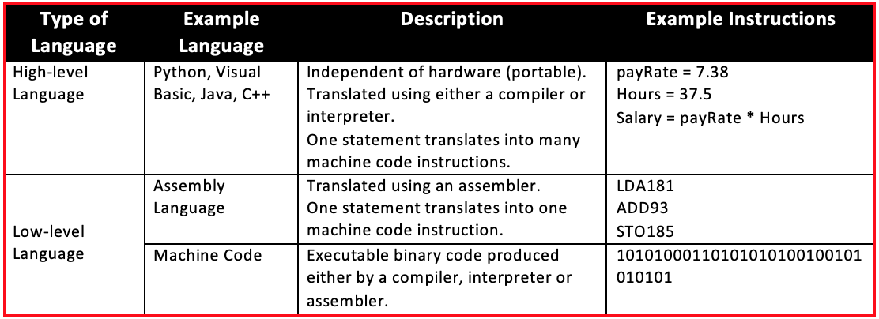
Example for high level language:
X=100
If balance x:
print ‘insufficient balance’
Else:
print ‘take your name’

Slide 17
Comparison – ML, AL and PL
 | Machine Language | Assembly Language | Programming Language
Level | low | low | high
Ease of Comprehension | machine | human | human
Syntax Nature | 0’s 1’s | ADD SUB MOV | Printf, scanf While do If else
Dependency | Platform dependent | Platform dependent | Platform independent
Modification | ✓ | ✗ | ✗
Compiler | ✗ | ✓ | ✓
Abstraction | No | Low | High

Slide 18



Interpreter
Language
Processor
Compiler
Translator
Assembler
Assembler | Compiler | Interpreter
Program that converts assembly level language (low level language) into machine level language. | Program that compiles entire source code into machine code. | Program that converts source code into intermediate code and then this intermediate code is executed line by line.

Slide 19
Summary
Interface / Communication between user and machine.
System Software and its types.
Language processors and semantic gap.
Two levels of languages.
How machine understands and works with 0’s and 1’s.
Machine language, assembly language and programming language.
Compiler, assembler and interpreter.

Slide 20
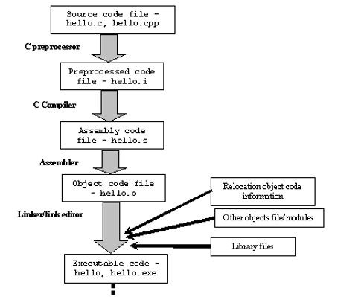
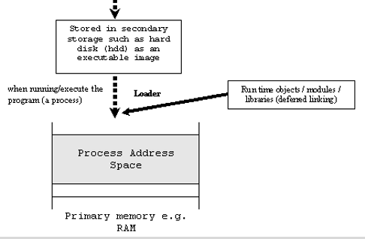
Language Processing System – Structure
Skeletal source program
Pre processor
source program
Compiler
Target assembly program
Assembler
Relocatable machine code
Linker / Loader
Absolute machine code

Slide 21
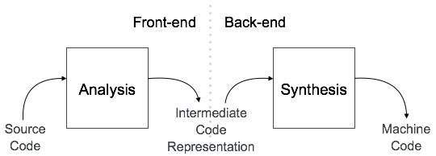
Types and Phases of Compiler
Single
pass
Multi
pass
Load
&
Go
Types of Compiler
Phases of Compiler
Analysis
Synthesis
Breaks source program into
constituent pieces.
Creates intermediate representation
of source program.
Constructs desired target
program from intermediate
representation.
Requires most specialized
techniques.
Debugging
Optimizing

Slide 22
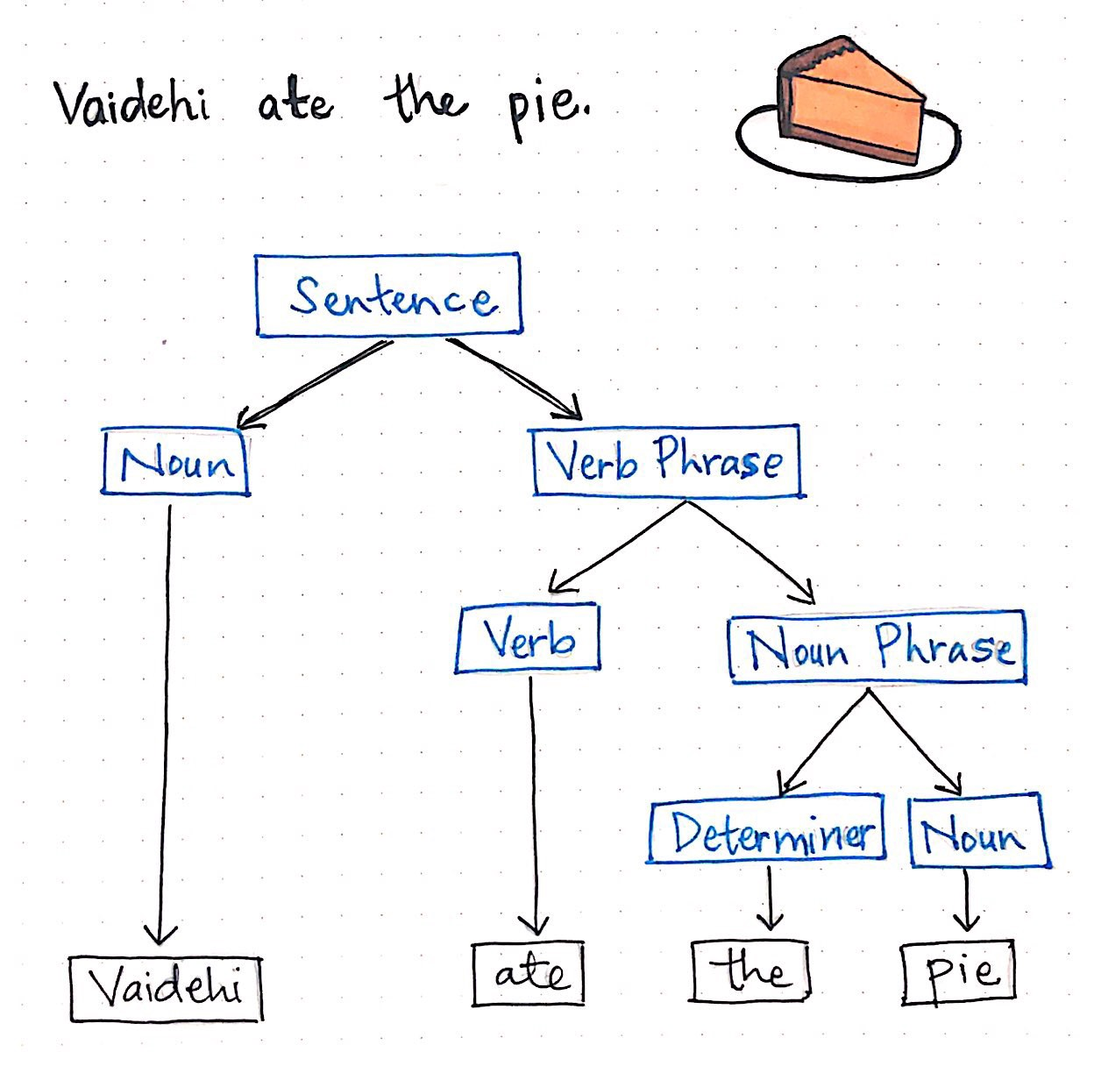
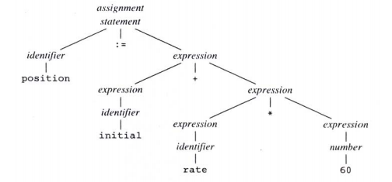
Analysis Phase
Operations implied by the source program is determined and recorded in a hierarchical structure
called tree.
Special tree -> Syntax tree
Node -> represents the operator
Child -> represents the operand

Slide 23
Context behind Analysis phase:
Source program -> divided into modules -> each module stored in separate file -> combined lastly.
Types of Analysis
Linear Analysis
Hierarchical Analysis
Semantic Analysis
Stream of characters
That forms source program
Read from left to right
Grouped into “tokens”
Tokens – sequence of
characters having collective
meaning.
Characters / tokens grouped
together hierarchically
into nested collections
with
collective meaning.
Performed to make sure
that the component of
the program fit
together meaningfully.

Slide 24
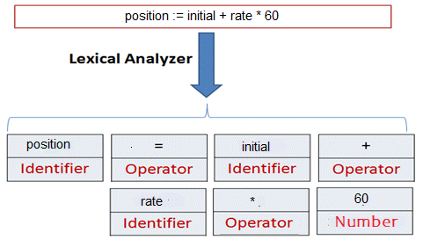
Lexical Analysis or Scanner
Reads characters in the source code and groups them into meaningful word called Token.
Pattern: Rule for a set of string in the input for which a token is produced as output.
Tokens - types
Keywords | Meaning
Operators | Symbols that operate on arguments and return value.
Identifiers | Variable names, things used to identify / refer things in code used by user
Constants | Numbers
Literals | Any string, number or literal logical value
Strings | Words
Punctuations | Punctuators including braces and parenthesis.
Input: stream of characters
Output: Token

Slide 25
Syntax Analysis or Parser
Parser groups the tokens produced by lexical analyzer into grammatical phrases or syntactic
variables.
Generates a tree like representation called parse tree .
A parse tree describes the syntactic structure of the input.
Recursive Rules:
Any identifier is an expression.
Any number is an expression.
If expression1 and expression2 are expressions
then so are,
expression1 + expression2
expression1 * expression2
Parse tree for position :=initial + rate * 60

Slide 26
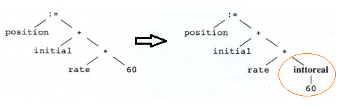
Semantic Analysis
Checks for semantic errors.
Concentrates on Type checking -whether operands are type compatible.
e.g. real number used to index an array.
Semantic analysis inserts a conversion of integer to real

Slide 27
input
Statement 1: a = b + c;
Statement 2: d = c * 60;
Syntax Analysis
Lexical Analysis
Assignment op
a – id1
b – id2
c – id3
d – id4
= → operator
+ → operator
‘*’→ operator
60 – number
Expression
id1
Sum op
Expression
id2
Expression
id3
Assignment op
Expression
id4
Product op
Expression
id3
Expression
number

Slide 28
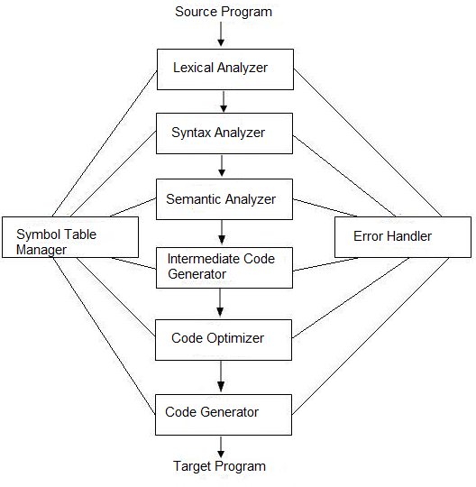
Phases of Compiler

Slide 29
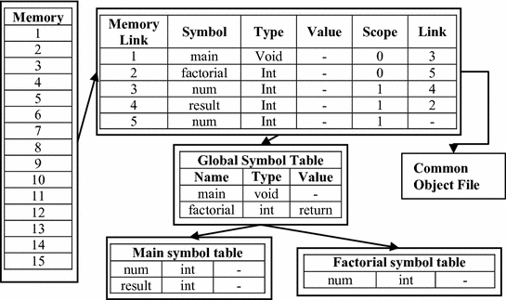
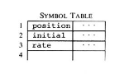
Symbol table management
Compiler’s function: record identifiers used in source program and collect information about
various attributes.
Attributes – identifier, scope, type, Functions: Function name, no of argument, type and method
All these will be stored and managed by a data structure called “symbol table”
It contains record for each identifier with fields for attributes of the identifier.
Allows to find record for each identifier quickly, store and retrieve data from that record quickly.

Slide 30
Error Detection and Reporting
Each phase encounter errors.
After detection, compilation proceeds and finds all further errors.
Shouldn’t stop after encountering the first error.
Few errors:
In lexical analysis: misspelled name of some identifier.
In syntax analysis: missing semicolon or unbalanced parenthesis.
In Semantic analysis: Type mismatch.
In code optimization, errors occur when the result is affected by the optimization.
In code generation, it shows error when code is missing etc.

Slide 31
Intermediate Code Generation
Produces intermediate representations for the source program which are of the following forms:
Postfix notation
Three address code
Syntax tree
Commonly used form is the three address code.
In the eg. Temp1, Temp2 and Temp3 are compiler generated temporary variables.
Properties of intermediate code
It should be easy to produce and easy to translate into target program.
Atmost one operator in addition to assignment.
Generate temporary name to hold value computed by each instruction.
Some three address code instructions have fewer than three operands.
(Eg. First and Last)
Temp1 = inttoreal(60)
Temp2 = id3 * Temp1
Temp3 = id2 + Temp2
id1 = Temp3

Slide 32
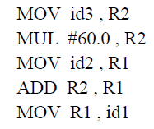
Code Optimization and Code Generation
Optimization:
Improves and produces optimized intermediate code as output. e.g.,
t₁ = id₃* 60.0
id₁ = id₂ + t₁
Helps in generating fast running machine code.
Generation:
Intermediate instructions are translated into a sequence of machine instructions that perform the same task.
Using registers R1 and R2 the translation of the e.g. is:

Slide 33
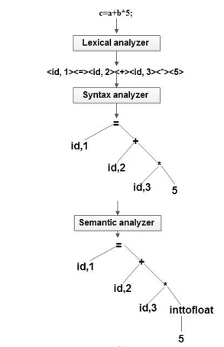
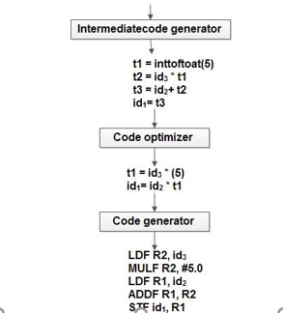

Slide 34
Lexical Analyzer
Construct a diagram that illustrates the structure of tokens of source prog
To build a lexical analyzer
Hand translate the diagram into program for finding tokens
Query languages
Lexical Analyzer
Can also be used in
Information retrieval systems
Pattern directed programming
Pattern action language called “lex”
Patterns are specified by regular expressions.
Compiler for lex generate efficient finite automata recognizer for regular expression.

Slide 35
Role of Lexical Analyzer
Main task → read input characters, output a sequence of tokens that parser uses for syntax analysis.
Lexical analyzer → subroutine or coroutine of the parser.
Parser sends → “get next token” → LA reads input characters until it finds the next token.
Secondary tasks:
*Stripping out the following from source program*
*Correlating error messages from the compiler
with the source program*
Eg. Line number associated with an
error message.
token
Source
Program
Lexical
Analyzer
Parser
Get next
token
Comments
White spaces (blank)
Tab
Newline characters
Symbol
Table

Slide 36
Lexical Analysis - Steps
Scanning
Responsibility: simple tasks → eg. eliminates blank
Steps
Evaluation
Responsibility: complex tasks → eg. Evaluate token
Why scanning and parsing performed as separate steps in analysis phase?
Important consideration → simpler design and well defined roles and responsibilities.
Compiler efficiency → improved (specialized buffering techniques – lex phase)
Compiler portability → enhanced
Keywords:
Tokens | Names | Certain set of input → takes same token name
Patterns | Informal description | Set of strings described by a rule called “pattern” associated with the token.
Lexemes | Actual value | Sequence of character in the source program that is matched by the pattern for a token.

Slide 37
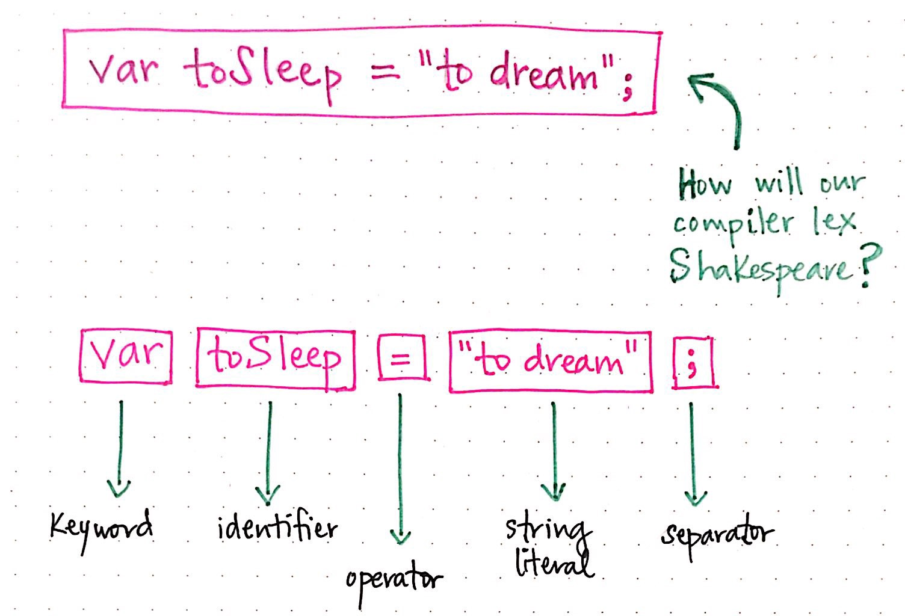
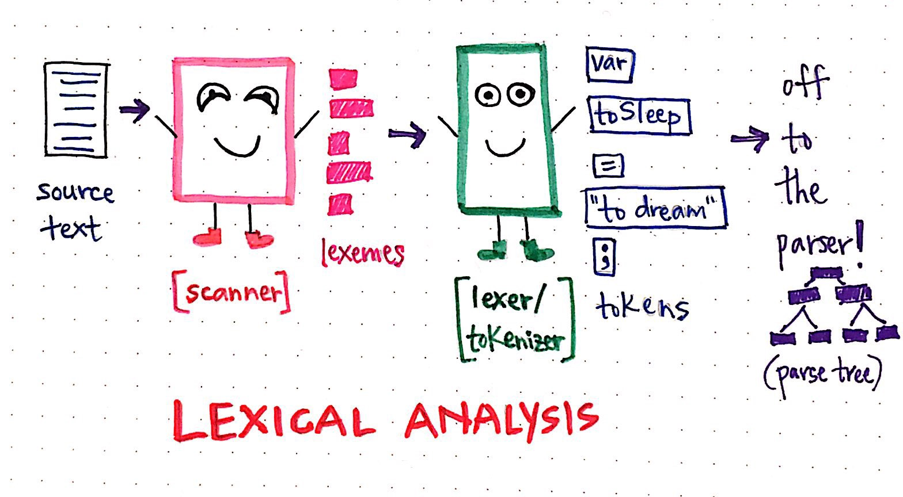
Examples that differentiate token, pattern and lexeme:
Token | Informal description of pattern | Sample lexeme
if | Characters I, f | If
else | Characters e, l, s e | else
relation | < or > <= or >= or == or != | <, <=, =, ==, > >=
id | Letter followed by letters and digits | Pi, count, D2
num | Any numeric constant | 3.1416, 0, 6.02E23
literal | Anything but “, surrounded by “ ‘s | “core dumped”

Slide 38
Example Program
Tokens generated
#include<stdio.h>
int maximum(int x, int y)
{
// this will compare two numbers if(x>y)
return x;
else
return y;
}
int main()
{
// get input from user
and pass it to max func.
int x, y, result;
printf(“inputs: /t”);
scanf(“%d %d”,&x,&y);
result = maximum(x,y);
printf(“output:
maximum number
is %d /n”,result);
return 0;
}
Lexeme | Token
int | Keyword
maximum | Identifier
( | Operator
int | Keyword
x | Identifier
, | Operator
int | Identifier
y | Identifier
) | Operator
{ | Operator
if | keyword
( | Operator
x | Identifier
> | Operator
y | Identifier
) | Operator
Non tokens in the program
Type | Examples
Comment | // this will compare two numbers
Pre – processor directive | #include<stdio.h>
whitespace | /n /b /t

Slide 39
Attributes for Tokens:
One pattern → matches two or three lexemes at times. Eg. Num matches for both strings ‘0’ and ‘1’
The pattern mismatch might lead to serious bugs during the code generation phase
token
Influence parsing decisions.
Lexical analyzer
Attributes
associated
Influence translation of tokens.
Practically → token → single attribute → “pointer” to the symbol table entry → stores information about the token → pointer = attribute of token
Symbol table
Token
Lexeme of the token
Line number it was first seen in the source code

Slide 40
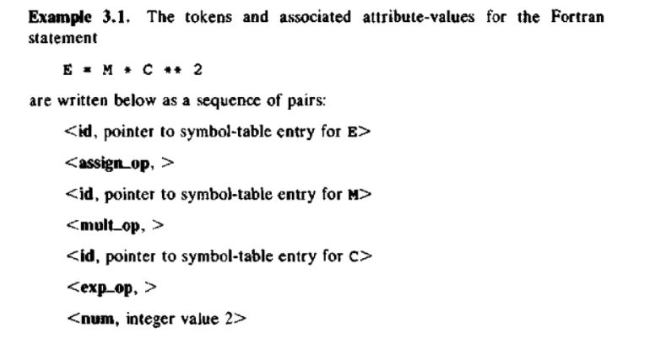
Example for Token Attributes

Slide 41
Lexical Errors
Lexical analyzer → has a very localized view of a source program
Eg.
fi(x==3 && y>=4) LA cannot tell whether fi is a misspelling of keyword ‘if’ or is it a
separate name of an unidentified identifier
Solutions
“panic mode”
recovery
Deleting an
extraneous
character.
Inserting a
missing
character.
Replacing an
incorrect
character
by correct
character.
Transposing two
adjacent
characters.
Delete successive
characters from
remaining input
until well defined
token is formed.
Simple strategy to
See prefix of remaining input can be transformed into valid
Lexeme – by just single transformation.
Error transformations
Assumes most lexical errors are result of single error transformation.

Slide 42
Input/output buffer – Temporary storage location that holds all incoming and outgoing data before and after it continues to CPU for processing
Input Buffering
The lexical analyser scans the input from left to right one by
one at a time.
General three approaches to build Lexical Analyser:
Lexical - analyser generator – Lex Compiler (RE based).
Conventional system programming language – using IO.
Lexical Analyser in assembly language – explicitly manage
Input reading.
Listed in the order of increasing
difficulty for the implementation
More difficult – faster lexical analyser
Why lexical phase implementation is important?
Reads character by character – spends considerable amount of time (though later phases are complex).
Speed of Compiler is decided by the lexical phase mainly.

Slide 43
Forward pointer
Keep track of the input scanned
For scanning, lexical analyser uses two pointer
Backward pointer
Eg. int n, num, result;
Initially fp and bp starts at the same point
bp
i | n | t |  | n | , | n | u | m | , | r | e | s | u | l | t | ;
fp
Then fp moves until it finds lexeme with meaning
bp
i | n | t |  | n | , | n | u | m | , | r | e | s | u | l | t | ;
fp
bp
Look ahead
i | n | t |  | n | , | n | u | m | , | r | e | s | u | l | t | ;
As soon as blankspace is encountered – indicates the end of lexeme.
fp
bp
i | n | t |  | n | , | n | u | m | , | r | e | s | u | l | t | ;
fp

Slide 44
bp
Fp and bp moves to the next token
i | n | t |  | n | , | n | u | m | , | r | e | s | u | l | t | ;
fp
Lexical analyser ignores the blank space and moves to the next character.
Both the bp and fp pointers are moved towards the next token after encountering space.
In the example, when fp reaches blank, it identifies the lexeme “int”.
The process performed here is termed as look ahead
Lexical analyzer needs to look ahead several characters beyond the lexeme for a pattern before
a match can be announced.
Reading the input character from secondary storage is going to cost a lot
Large amount of time can be consumed for moving characters
A block of data is first read into a buffer and then second by lexical analyser.
this is where “buffering
Technique” comes into existence.
Reduces the amount of overhead required to process an input character.

Slide 45
One buffer scheme
One buffer is used to store the input string
Buffering schemes
Two buffer scheme
Two buffers are used to store the input string
One buffer scheme
Eg, for(i=1;i<=n;i++)
bp
f | o | r | ( | i | = | 1 | ; | i | < | = | n | ; | i | + | + | )
fp
Eg, for(i=1,j=1;i<=n,j<=m;i++,j--)
bp
f | o | r | ( | i | = | 1 | , | j | = | 1 | ; | i | < | = | n | ,
fp

Slide 46
Disadvantage with one buffer scheme:
When lexeme is very long and crosses the buffer boundary, to scan rest of the lexeme the buffer
has to be refilled which might lead to over writing the lexeme.
To overcome
the disadvantage
Two buffer scheme:
In here two buffers are used by dividing a single buffer into two N - character halves where
N is the number of characters that fits the buffer.
N input characters are filled in each half of the buffer with single system read command
instead of invoking read command for each character.
Eg, for(i=1,j=1;i<=n,j<=m;i++,j--)
f | o | r | ( | i | = | 1 | , | j | = | 1 | ; | i | < | = | n | ,
j | < | = | m | ; | i | + | + | , | j | - | - | )

Slide 47
If fewer than N characters are there in the input → a special character “eof” is read into the buffer
After the input characters.
Eof → marks the end of the source file
→ different from any other input character.
bp
Iteration 1
f | l | o | a | t |  | r | a | d | i | u | s | ; | eof
fp
bp
Iteration 2
f | l | o | a | t |  | r | a | d | i | u | s | ; | eof
.
.
.
fp
bp
Iteration 5
f | l | o | a | t |  | r | a | d | i | u | s | ; | eof
fp
String of characters between the two pointers – current lexeme

Slide 48
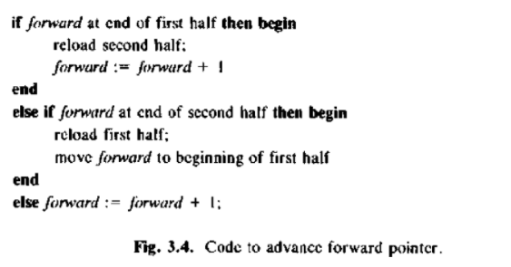
Short Comings:
This buffering technique works well most of the time → but the lookahead time is limited.
which might make it impossible to recognize tokens with more no of arguments.
Because, in this case fp might have to travel more than the length of the buffer.
Eg,
marks[50] | marksdisplay(int mat[], int sci[], int tam[], int eng[], int soc[]);
Amount of lookahead needed = proportional to the number of arguments
m | a | r | k | s | [
. . .
m | a | r | k | s | d
. . .

Slide 49
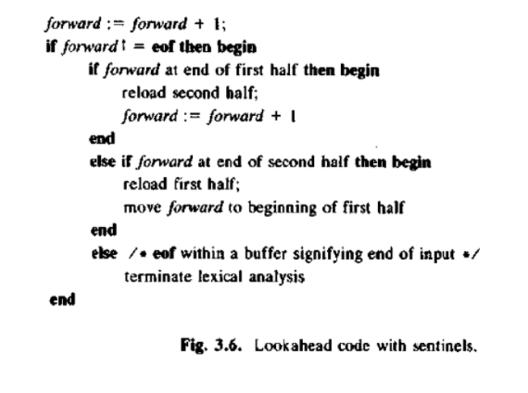
Sentinals:
In the previous code two tests are performed to check if the pointer has reached the end of
the file which can be reduced with the help of sentinel.
Sentinal is a special character that cannot be a part of source code. Eg. Eof
Most of the time, the code performs test only one time to see whether fp points to eof.
Mostly all the N characters in the input source file are encountered before reaching eof.

Slide 50
Patterns = matches set of strings
Serves as names for set of strings
Specification of tokens
Regular Expression → important notation for specifying patterns
Pattern directed language for lexical analysis
Basic Terminologies:
Term | Meaning | Example
Alphabet or Character | Denotes any finite no of symbols | {0,1} – binary alphabets ASCII – computer alphabets.
String (sentences, words) | Finite sequence of symbols drawn from the alphabets | “computer”
Language | Set of strings over some fixed alphabet | Empty set
String name | Length - |s|
sathyabama | 10
computer | 8
bat | 3
Length of string - |s| - eg. “banana” -|6|
Empty string – ε – special string of length zero

Slide 51
Terms for parts of string
Terms | Definition | Example (computer)
Prefix | String obtained by removing zero or more trailing symbols | Com
Suffix | String obtained by deleting zero or more leading symbols | Ter
Substring | String obtained by deleting a prefix and suffix | pu
Proper prefix/suffix/substring | Any non empty string that is prefix, suffix or substring but is not same as the string. | Com, Ter, pu – Proper Computer – not proper
Subsequence | String obtained by deleting zero or more not necessarily continuous symbols | cmue
Union
Operations
Performed
On
languages
Concatenation
Closure

Slide 52
Example
L : {A, B, C, D,………….,Z, a, b, c, d,……………,z} – alphabet consisting of set of upper and lower
case letters
D: {0, 1, 2, 3,………….., 9} – alphabet consisting of the set of the ten decimal
digits
The sets L and D are finite languages → below are the examples of new languages created
Language | Explanation | Example
L U D | Set of letters and digits | {A,B,C..,a,b,c...,0,1,2..}
LD | Set of strings consisting of a letter followed by a digit | {a,1,b,2,c,3…}
L^4 | Set of all four letter strings | {xxxx, xxyy, xyxy,….}
L* | Set of all strings of letters including empty string | {ε, a, b, ab, ba, aba, aab, …}
L(L U D)* | Set of all strings of letters and digits beginning with a letter | {ε, a6, A5, aab9, a954, abcd8,…}
D+ | Set of all strings of one or more digits | {1, 23, 123, 432, 4567..}

Slide 53
Operation | Equation | Example
Concatenation |  | L1 = {xy} L2 = {xyy} L1L2 = {xyxyy}
Union |  | L1 = {xy} L2 = {xyy} L1L2 = {xyxyy}
Exponentiation |  | L = {xy} L0 = {ε} L1 = {xy} L2 = {xyxy}
Kleene Closure |  | L = {xy} L* = L0 U L1 U L2 U … L* = {ε, xy, xyxy, xyxyxy, …}
Positive Closure |  | L = {xy} L = L1 U L2 U L3 U … L = {xy, xyxy, xyxyxy, …}

Slide 54
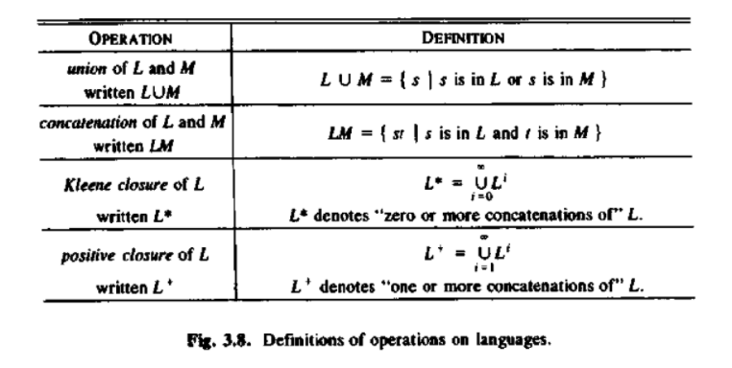
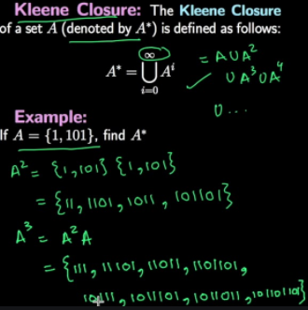
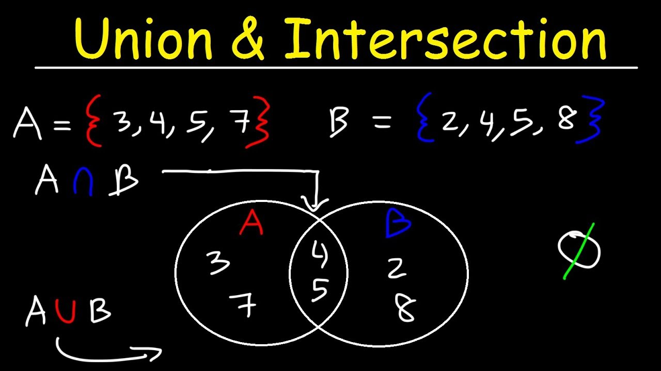
Definitions of operations on Languages

Slide 55
Regular Expressions
| - vertical bar – denotes or
letter ( letter | digit ) *
() – parenthesis – groups sub expressions
* – zero or more instances of paranthesized expression
Regular expression → built up out of simpler regular expressions using set of defining rules
Each regular expression r → denotes a language L(r)
Rules – specify how L(r) is formed by combining various sub expressions.
ε is a regular expression, L(ε) = {ε}
If a is a symbol in ∑ then a is a regular expression, L(a) = {a}
Suppose r and s are regular expressions denoting the language L(r) and L(s)
(r) | (s) is a regular expression denoting the language L(r) ∪ L(s)
(r)(s) is a regular expression denoting the language L(r)L(s)
(r)* is a regular expression denoting (L(r))*
(r) is a regular expression denoting L(r)

Slide 56
Unnecessary parenthesis can be avoided in regular expression if we adopt the conventions that:
The unary operator * has the higher precedence and is left associative.
Concatenation has the second highest precedence and is left associative.
| has the lowest precedence and is left associative.
Under these conventions (a)|((b)*(c)) is equivalent to a|b*c.
denote the set of strings that are either a single a or zero or more b’s followed by one c .

Slide 57
Basic Examples
Regex | Matches any string that
hello | {hello}
gray|grey | {gray, grey}
gr(a|e)y | {gray, grey}
b[aeiou]bble | {babble, bebble, bibble, bobble, bubble}
go*gle | {ggle, gogle, google, gooogle, gooogle…}
go+gle | {gogle, google, gooogle, gooogle…}
g(oog)+le | {google, googoogle, googoogoogle…}

Slide 58
Writing Regular Expressions
Regular Expression | Set
a|b | {a,b}
(a|b)(a|b) | {aa, ab, ba, bb}
a* | {ε, a, aa, aaa, …}
(11)* | {ε, 11, 1111, 111111, …}
(11)*.1 | {1, 111, 11111, …}
(a)(a|b)* | {a, ab, aba, aab, …}
(a|ab)(a|b)* | {a, ab, aba, aab, …}
(a|b)* | {ε, a, b, ab, ba, aba, aab, …}
(a|b)*abb | {abb, aabb, babb, baabb, …}

Slide 59
Algebraic Properties of regular expression
Axiom | Description | Meaning
r|s = s|r | | is commutative | Commutative: a+b = b+a
r| (s | t) = (r | s) | t | | is associative | Associative: a*(b*c) = (a*b)*c
(r s) t = r (s t) | Concatenation is associative | Associative: a*(b*c) = (a*b)*c
r (s | t) = rs | rt (s | t) r = sr | st | Concatenation distributes over | | Distributive: a(b + c) = ab + ac
rε = r εr = r | ε - identity for concatenation | Identity: a*1 = a
(r | ε)* = r* | Relation between r and ε
r** = r* | * is idempotent

Slide 60
Regular Definition
Notational convenience → regular expressions are assigned with names and defined using it
as if they were symbols.
- Alphabet of basic symbols
Regular definition – sequence of definition of the form
d1 → r1
d2 → r2 di – distinct name
… ri – regular expressions over (basic symbols and previously defined names)
dn → rn
By restricting reg exp(r1, r2, … rn) to over the symbols of and the previously defined names →
Further regular expressions can be constructed by repeatedly replacing reg exp names by expressions they denote.

Slide 61
Examples:
L → A|B|C|..……….|Z|a|b|c|…...…………|z – alphabet consisting of set of upper and lower
case letters
D → 0|1|2|3|…………..|9 – alphabet consisting of the set of the ten decimal
digits
Id → letter (letter | digit)*
Regular Definition | Description
digit → 0|1|2|3|…………..|9 | Set of numbers
digits → digit digit* | At least one digit - followed by set of numbers
optional_fraction → . digits | ε | Decimal point – followed by digits or empty string
optional_exponent → ( E ( + | - | ε ) digits ) | ε | E – followed by + or – sign – followed by one or more digits
num → digits optional_fraction optional_exponent | Set of digits, optional_fraction and optional_exponent

Slide 62
Notational Shorthands
One or More Instances | Unary postfix operator “+”
 | If r denotes language L(r) → r+ denotes language (L(r))+
 | Eg. a+ → set of all strings of one or more a’s
Zero or one instance | Unary postfix operator “?”
 | Shorthand for r |ε
 | If r is regular expression → (r)? Is a regular expression that denotes the language L(r) u {ε}
Character classes | Abbreviated character class
 | Describe identifiers as strings generated by regular expressions
 | Eg. {a,b,c,….,z} can be denoted as |a-z|

Slide 63
Examples: (After applying Notational short hands)
L → A|B|C|..……….|Z|a|b|c|…...…………|z – |A-Za-z|
D → 0|1|2|3|…………..|9 – |0-9| Set of Alphabets followed by digits – |A-Za-z0-9
Regular Definition (Before using shorthand) | Regular Definition (After using shorthand)
digit → 0|1|2|3|…………..|9 | digit → |0-9|
digits → digit digit* | digits → digit+
optional_fraction → . digits | ε | optional_fraction → (. digits)?
optional_exponent → ( E ( + | - | ε ) digits ) | ε | optional_exponent → ( E ( + | - )? digits )?
num → digits optional_fraction optional_exponent | num → digits optional_fraction optional_exponent
Relation between Kleene and positive closure operators:
r* = r + ε and r+ = rr*

Slide 64
Recognition of tokens
Consider the below fragment of code:
Stmt → if expr then stmt | if expr then stmt else stmt |
Expr → term relop term | term
Term → id | num
token | generated regular expression
if | if
then | then
else | else
relop | < | <= | + | <> | > | >=
id | letter ( letter | digit )*
num | digit+ (. digit+) ? (E ( + | - )? digit+ )?

Slide 65
For the language format given, the lexical analysis will recognize the following tokens
For simplification,
the foll assumptions
are made:
1) keywords are reserved and cannot be used as identifiers
2) lexemes are separated by white space (nonnull sequences of blanks, tabs and newlines)
if, then and else
keywords
lexemes
relop, id and num
Lexical Analyzer will strip out white space by comparing a string against the regular definition
Whenever a match for ws is found, Lexical analyser does not return a token to the parser.
Rather, it proceeds to find a token following the white space and returns that to the parser.
delim → blank | tab | newline
ws → delim+

Slide 66
Goal : Construct a lexical analyser that will isolate the lexeme for the next token in the input
buffer and produce as output pair consisting of appropriate token and attribute value
using translation table.
Regular Expression | Token | Attribute Value
ws | - | -
if | if | -
then | then | -
else | else | -
id | id | pointer to table entry
num | num | pointer to table entry
< | relop | LT
<= | relop | LE
= | relop | EQ
<> | relop | NE
> | relop | GT
>= | relop | GE

Slide 67
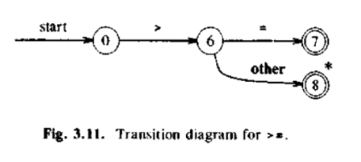
Transition Diagram
Stylized flowchart
Position drawn as circles
depict the actions that take
Transition diagram → place when lexical analyzer is
called by parser to get the
next token.
states
States connected by arrows
edges
0 6 7 8 | States
> = other | Edges
Double circle | Accepting state where token is found
* | Input retraction must take place.

Slide 68
Input retraction
In general, there will be many transition diagrams → each specifying a group of tokens.
On account of failure while following single transition diagram →
1) Forward pointer is retracted to the starting point where it was in start state
2) Activate next transition diagram
Input retrac-
-tion
Lexeme beginning and forward pointers marked the same position in the start state of the
diagram, the forward pointer is retracted to the position marked by lexeme-beginning pointer.
If failure occurs in all transition diagrams, then a lexical error has been detected and error
recovery technique is invoked.

Slide 69
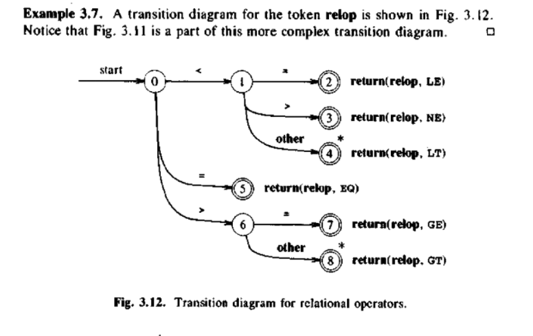
Example
0 1 2 3 4 5 6 7 8 | States
< = > other | edges
return(relop, LE) return(relop, NE) return(relop, LT) return(relop, EQ) return(relop, GE) return(relop, GT) | returns <= operator returns <> operator returns < operator returns = operator returns >= operator returns > operator

Slide 70
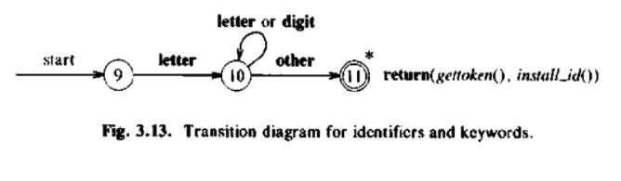
9 10 11 | States
letter letter or digit other | edges
return(gettoken(), install_id()) | token and attribute value
To separate keywords from identifiers → initialize symbol table in which the information about
identifier is stored.
gettoken() → returns token → looks for lexeme in the symbol table (keyword or id is returned)
install_id() → returns attribute value of the token from the symbol table
has access to the buffer where the identifier lexeme has been located
if lexeme is identified as keyword → returns zero
install_id()
if lexeme is identified as program variable → returns pointer to symbol table entry

Slide 71
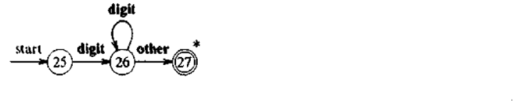
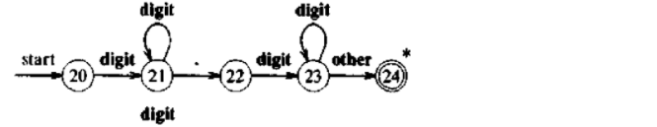
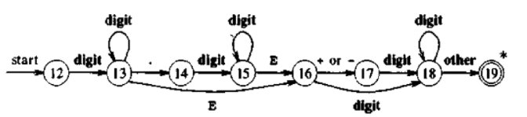
digits → digit+
25 26 27 | States
digit other | edges
optional_fraction → . digits | ε
20 21 22 23 24 | States
digit . other | edges
num → digits optional_fraction optional_exponent
12 13 14 15 17 18 19 | States
digit . other | edges

Slide 72
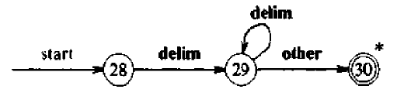
Dealing with white space
28 29 30 | States
delim other | edges
There’s nothing to return when whitespace is found in the input.
Nothing is returned when the accepting state is reached.
Goes back to first transition diagram to look for another pattern.

Slide 73
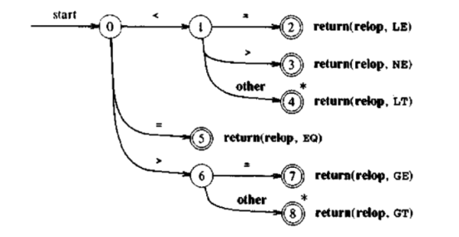
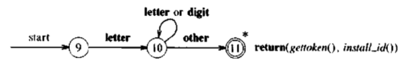
if(x>=10)
x=x-19;
else
x=x+19;
Example code:
(3) >=
(1) if
(2) x
(5) else
(4) 10
White space
(6) 19

Slide 74
while(radius > 0)
area = 3.14 * radius
*radius;
return area;
Example code:
(1) while
(2) radius
(4) area
(7) return
(3) >
(5) =
(6) 3.14
White space

Slide 75
Transition Diagram - Implementation
Sequence of transition diagram → converted into program to look for tokens specified by the
program.
Each state gets a segment of code.
For edges leaving a state, code reads a character and selects an edge to follow.
Read the next character from the input buffer
Global variable
lexical_value –
Assigned pointers to
install_id()
Nextchar()
Advance the forward pointer at each call
Return the character read.
install_num()
No such edge → indicates there’s
no token found, so routine fail() is
invoked to retract the forward poi-
-nter to the beginning.
Edge labelled with character read
Control transferred to the code for the state
Pointed by that edge
State

Slide 76
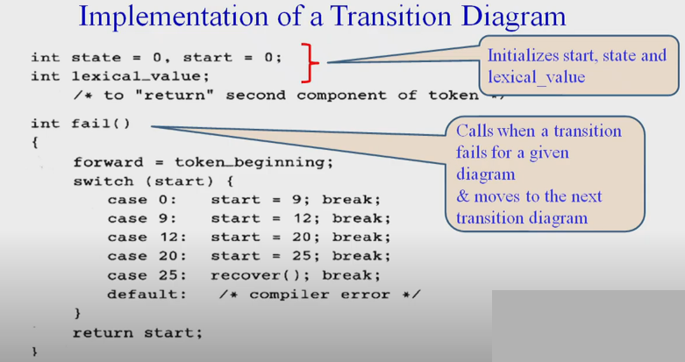
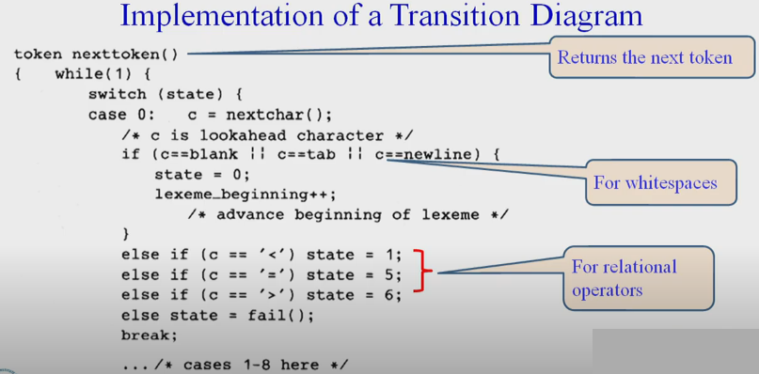

Slide 77
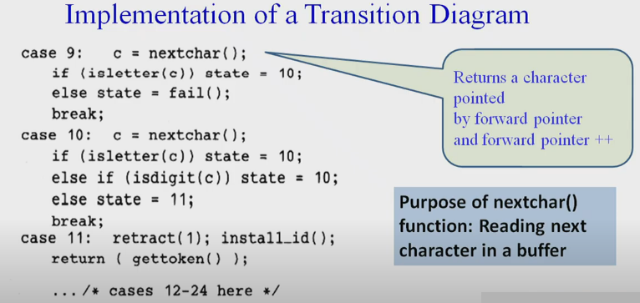
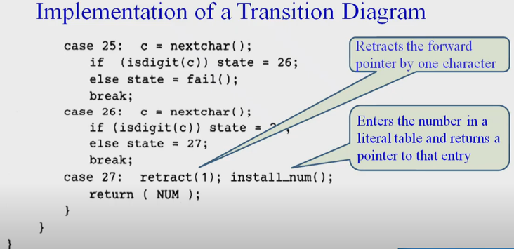

Slide 78
Finite Automata
Recognizer for a language - program
Generalized transition diagram to compile regular expression into a recognizer
A machine that accepts Regular Language
Some
string
“x”
“x” is a
sentence
of a lang
input
output
output
Applications:
Compliers
Text processing
Hardware design
“x” is not a
sentence
of a lang
Non - Deterministic Finite Automata
Types of
Finite Automata
Deterministic Finite Automata

Slide 79
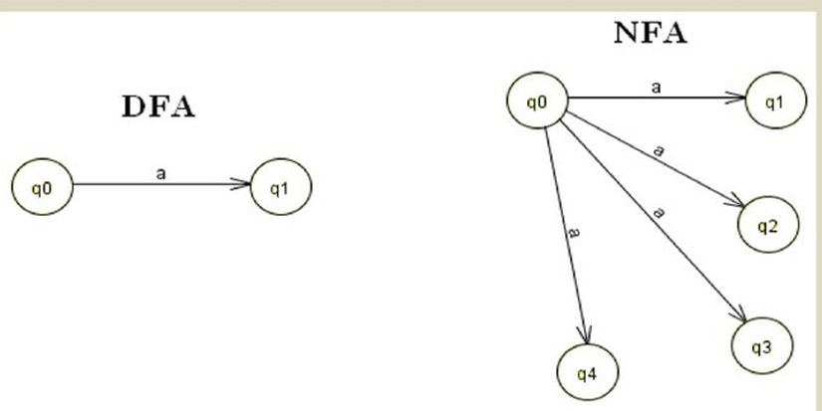
Deterministic Finite Automata:
Only one transition out of a state is possible on same input symbol.
Leads to faster recognizers.
Non Deterministic Finite Automata:
More than one transitions are possible on same input symbol.
Precise and smaller than DFA for same regular expression.
Both are capable of recognizing precisely the regular sets.

Slide 80
Non – Deterministic Finite Automata
Same character can label two or more transitions out of one state.
Edges can be labelled either by special symbol or input symbols.
NFA is a mathematical model that consists of:
a set of states s
a set of input symbols ∑ (input symbol alphabet)
a transition function move that maps state-symbol pairs to set of states
a state s₀ that is distinguished as the start or initial state
a set of states F distinguished as accepting or final states.
Nodes - State
NFA
Transition Graph
Represented diagrammatically
Edges – Transition Function

Slide 81
NFA for (a|b)*abb
a
State | Input symbol
 | a | b
0 | {0,1} | {0}
1 | - | {2}
2 | - | {3}
3 | - | -
start
a
b
b
0
1
2
3
b
set of states - {0,1,2,3}
input symbol alphabet - {a,b}
start state - state 0
accepting state – state 3 (indicated by double circle)

Slide 82
Deterministic Finite Automata
DFA is a special case of non deterministic finite automaton, in which
→ No state has an transition i.e., a transition on input
→For each state s and input symbol a, there is at most one edge labelled a leaving s.
b
a
start
a
b
b
0
1
2
3
DFA for (a|b)*abb
a
b
a

Slide 83
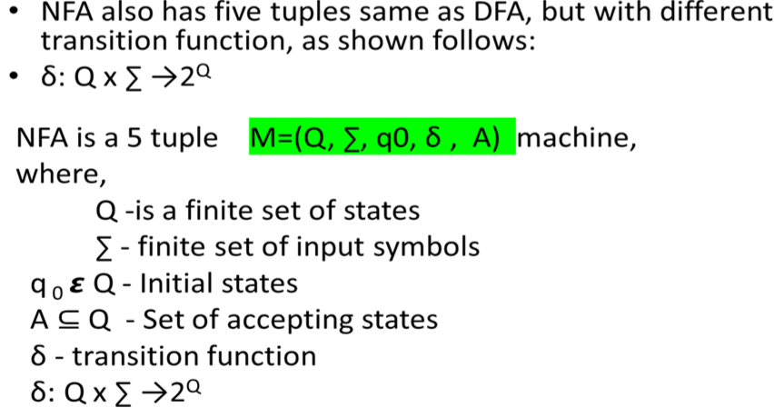
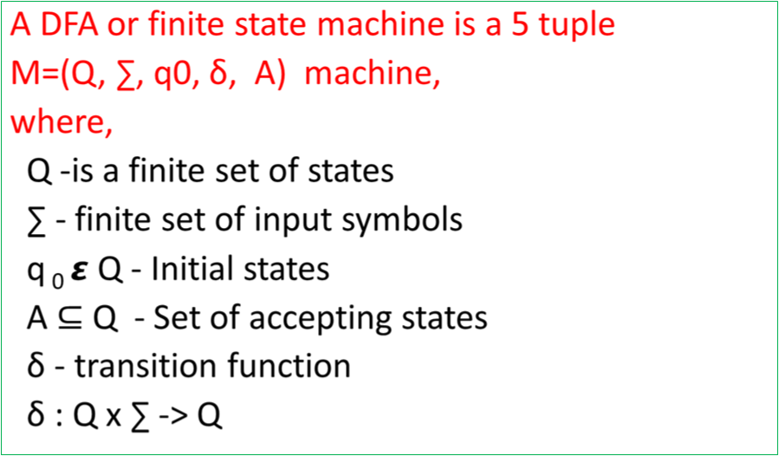
Formal Definition NFA vs DFA

Slide 84
Notations
Flow
Name | Notation
State
Start State
Accepting State
Transition
Regular Expression
NFA
DFA
Minimized DFA
label

Slide 85
Thompson’s Construction method for NFA
star
Operations performed in regular expressions
concatenation
or
Thompson’s for Star operation:
a* = {ε, a, aa, aaa, …}
{ε}
q0
ε
q1
{a}
q0
ε
q1
a
q2
ε
q3
exp | transition
ε | q0→q1
a | q0→q1→q2→q3
aa | q0→q1→q2→q1→q2→q3
aaa | q0→q1→q2→q1→q2→q1→q2→q3
.. | …….
a* | q0→[(q1→q2) loops for N times]→q3
ε
{ε,a,aa,aaa,aaaa….}
q0
ε
q1
a
q2
ε
q3
ε

Slide 86
Thompson’s for Concatenation operation:
NFA for a
q0
a
q1
exp | transition
a | q0→q1
b | q0→q1
ab | q0→q1→q2
NFA for b
q0
b
q1
q0
a
q1
b
q2
NFA for {ab}
Operation | No. of mandatory null moves
Star | 4
Concatenation | NIL
OR | 4

Slide 87
Thompson’s for OR operation:
NFA for a
q0
a
q1
NFA for b
q0
b
q1
q1
a
q2
ε
ε
exp | transition
a | q0→q1→q2→q6
b | q0→q3→q4→q6
NFA for (a+b) or (a|b)
q0
q6
ε
q3
b
q4
ε

Slide 88
Thompson’s construction for regular expression: (a|b)*abb
Step 1:
q1
a
q2
ε
ε
NFA for (a|b)
q0
q6
ε
q3
b
q4
ε
ε
q2
a
q3
Step 2:
ε
ε
NFA for (a|b)*
q0
ε
q1
q6
ε
q7
ε
q4
b
q5
ε
ε

Slide 89
Step 3:
NFA for abb
q0
a
q1
b
q2
b
q2
Step 4:
ε
NFA for (a|b)*abb
q2
a
q3
ε
ε
q0
ε
q1
q6
ε
q7
a
q8
b
q9
b
q10
ε
q4
b
q5
ε
ε

Slide 90
Syntax tree of Regular expression:
(a|b)*abb
Decomposition steps:
r₁₁
start
a
0
1
r₉
r₁₀
r₇
start
b
2
3
r₈
r₅
b
r₆
a
b
1
2
r₄
*
ε
a
ε
start
(
r₃
)
0
5
r₁
|
r₂
ε
ε
3
4
b
a
b

Slide 91
Decomposition steps:
r₁₁
ε
r₉
r₁₀
r₇
a
r₈
ε
2
3
r₅
b
start
ε
ε
r₆
0
1
ε
b
6
7
r₄
*
ε
ε
a
4
5
(
r₃
)
b
r₁
r₂
ε
|
a
b

Slide 92
Decomposition steps:
r₁₁
r₉
ε
r₁₀
r₇
r₈
a
r₅
b
ε
2
3
start
ε
ε
a
r₆
b
ε
r₄
0
1
*
6
7
8
a
ε
(
)
4
5
ε
r₃
b
r₁
|
r₂
ε
a
b

Slide 93
Final NFA
r₁₁
r₉
ε
r₁₀
r₇
r₈
a
r₅
b
2
3
ε
ε
r₆
b
r₄
start
ε
*
0
1
ε
a
b
b
a
6
7
8
9
10
(
r₃
)
ε
ε
4
5
b
r₁
|
r₂
ε
a
b

Slide 94
NFA to Minimized DFA Conversion
Subset Construction Method
Input: An NFA N
Output: A DFA D accepting the same language
Method:
Constructs a Transition table Dtran for D.
Each DFA state is a set of NFA states.
Constructs a transition table Dtran so that DFA D will simulate “in parallel” all possible moves NFA N can make on a given input string.

Slide 95
Operations used for Conversion
Operation | Description | Example
ε – closure(s) | Set of NFA states reachable from NFA state s on ε transitions alone
ε – closure(T) | Set of NFA states reachable from some NFA state s in T on ε transitions alone
move(T,a) | Set of NFA states to which there is a transition on input symbol a from NFA state s in T
0
ε
1
ε
2
0
ε
1
ε
5

Slide 96
ε
Example
NFA N for the Regular
Expression (a|b)*abb
Step 1
2
a
3
ε
ε
0
ε
1
6
ε
7
a
8
b
9
b
10
ε
4
b
5
ε
ε
Step 2
Pick out the Set of NFA states reachable from NFA state 0 on ε transitions alone
ε-closure(0) = {0,1,2,4,7} → Construct this as first DFA state A

Slide 97
Step 2
Pick out the Set of NFA states reachable from NFA state 0 on ε transitions alone
ε-closure(0) = {0,1,2,4,7} → Construct this as first DFA state A
NFA
2
DFA
ε
0
ε
1
7
A
ε
5
ε

Slide 98
Step 2.1
Compute ε-closure(move(A,a))
move(A,a) ={3,8}
ε-closure(move(A,a)) = ε-closure(3,8) = {3,8,6,7,1,2,4}
ε-closure(move(A,a)) ={1,2,3,4,6,7,8} → Constuct New DFA State B
Dtran[A,a]= B
2
a
3
B
ε
ε
a
0
ε
1
6
ε
7
a
8
A
ε
4
ε

Slide 99
DFA states | Input Symbols
 | a | b
A | B | C
B
C
Step 2.2:
Compute ε-closure(move(A,b))
move(A,b) ={5}
ε-closure(move(A,b)) = ε-closure(5) = {5,6,7,1,2,4}
ε-closure(move(A,a)) ={1,2,4,5,6,7} → Construct New DFA State C
Dtran[A,b]= C
ε
2
B
ε
a
0
ε
1
6
ε
7
A
ε
b
4
5
ε
C
b
ε

Slide 100
Step 3: Compute Transition from state B on input symbol {a,b}
B = {1,2,3,4,6,7,8}
Step 3.1: Compute ε-closure(move(B,a))
move(B,a) ={3,8}
ε-closure(move(B,a)) = ε-closure(3,8) = {3,8,6,7,1,2,4}
ε-closure(move(B,a)) ={1,2,3,4,6,7,8} → existing state B
Dtran[B,a]= B
DFA states | Input Symbols
 | a | b
A | B | C
B | B
C
a
ε
2
a
3
B
ε
ε
a
0
ε
1
6
ε
7
a
8
A
ε
b
4
C
ε

Slide 101
Step 3.2:
Compute ε-closure(move(B,b))
move(B,b) ={5,9}
ε-closure(move(B,b)) = ε-closure(5,9) = {5,9,6,7,1,2,4}
ε-closure(move(B,b)) ={1,2,4,5,6,7,9} → Construct New DFA State D
Dtran[B,b]= D
DFA states | Input Symbols
 | a | b
A | B | C
B | B | D
C
D
a
ε
2
B
b
D
ε
ε
a
0
1
6
ε
7
b
9
A
ε
4
5
b
C
b
ε

Slide 102
DFA states | Input Symbols
 | a | b
A | B | C
B | B | D
C | B
D
Step 4:
Compute Transition from state C on input symbol {a,b}
C = {1,2,4,5,6,7}
Step 4.1: Compute ε-closure(move(C,a))
move(C,a) ={3,8}
ε-closure(move(C,a)) = ε-closure(3,8) = {3,8,6,7,1,2,4}
ε-closure(move(C,a)) ={1,2,3,4,6,7,8} → existing state B
Dtran[C,a]= B
a
ε
2
a
B
b
D
3
ε
ε
a
0
ε
1
6
ε
7
a
8
A
a
ε
ε
4
5
b
C
b
ε

Slide 103
DFA states | Input Symbols
 | a | b
A | B | C
B | B | D
C | B | C
D
Step 4.2: Compute ε-closure(move(C,b))
move(C,b) ={5}
ε-closure(move(C,b)) = ε-closure(5) = {5,6,7,1,2,4}
ε-closure(move(C,b)) ={1,2,4,5,6,7} → existing DFA State C
Dtran[C,b]= C
a
ε
B
b
D
2
ε
a
0
ε
1
6
ε
7
A
a
ε
b
4
5
ε
C
b
ε
b

Slide 104
Step 5:
Compute Transition from state D on input symbol {a,b}
D = {1,2,4,5,6,7,9}
Step 5.1: Compute ε-closure(move(D,a))
move(D,a) ={3,8}
ε-closure(move(D,a)) = ε-closure(3,8) = {3,8,6,7,1,2,4}
ε-closure(move(D,a)) ={1,2,3,4,6,7,8} → existing state B
Dtran[D,a]= B
DFA states | Input Symbols
 | a | b
A | B | C
B | B | D
C | B | C
D | B
a
2
a
3
B
b
D
ε
ε
a
a
0
ε
1
6
ε
7
a
8
A
a
b
C
ε
4
b
5
ε
b
ε

Slide 105
DFA states | Input Symbols
 | a | b
A | B | C
B | B | D
C | B | C
D | B | E
Step 5.2:
Compute ε-closure(move(D,b))
move(D,b) ={5,10}
ε-closure(move(D,b)) = ε-closure(5,10) = {5,10,6,7,1,2,4}
ε-closure(move(C,b)) = {1,2,4,5,6,7,10} → New DFA State E
Dtran[D,b]= E
a
ε
B
b
D
2
ε
a
a
0
ε
1
6
ε
7
b
10
A
a
b
ε
b
4
5
ε
C
E
b
ε
b

Slide 106
Step 6: Compute Transition from state E on input symbol {a,b}
E = {1,2,4,5,6,7,10}
Step 6.1: Compute ε-closure(move(E,a))
move(E,a) ={3,8}
ε-closure(move(E,a)) = ε-closure(3,8) = {3,8,6,7,1,2,4}
ε-closure(move(E,a)) ={1,2,3,4,6,7,8} → existing state B
Dtran[E,a] = B
DFA states | Input Symbols
 | a | b
A | B | C
B | B | D
C | B | C
D | B | E
E | B
a
b
2
a
3
B
b
D
ε
ε
a
a
0
ε
1
6
ε
7
a
8
A
a
b
b
C
E
ε
4
b
ε

Slide 107
DFA states | Input Symbols
 | a | b
A | B | C
B | B | D
C | B | C
D | B | E
E | B | C
Step 6.2: Compute ε-closure(move(E,b))
move(E,b) ={5}
ε-closure(move(E,b)) = ε-closure(5) = {5,6,7,1,2,4}
ε-closure(move(E,b)) ={1,2,4,5,6,7} →existing state
Dtran[E,b]= C
ε
2
a
ε
B
b
D
b
0
ε
1
6
ε
7
a
a
ε
A
a
b
4
5
ε
b
b
C
E
b
ε
b

Slide 108
Step 7: No more new DFA states are formed.
Stop the subset construction method. DFA for (a|b)*abb
DFA= Subset of NFA
A = {0,1,2,4,7} start state
B = {1,2,3,4,,6,7,8}
C = {1,2,4,5,6,7}
D = {1,2,4,5,6,7,9}
E = {1,2,4,5,6,7,10} State E contains the NFA accepting state(state 10)
a
a
b
D
a
B
start
A
a
a
b
b
C
E
b
b

Slide 109
Minimization of DFA
The process of reducing a given DFA to its minimal form is called as minimization of DFA.
It contains the minimum number of states.
The DFA in its minimal form is called as a Minimal DFA.
Minimization of DFA (Methods)
Equivalence Theorem
Myhill Nerode theorem
(Table Filling Method)

Slide 110


Eliminate all the dead states and inaccessible states from the given DFA (if any).
Dead State
All those non-final states which transit to itself for all input symbols in ∑ are called as dead states.
Inaccessible State
All those states which can never be reached from the initial state are called as inaccessible states.
a
q4
b

Slide 111
Input: A DFA D with set of states S, set of inputs ∑, transitions defined for all states and inputs, start state s₀ and set of accepting states F.
Output: A minimized DFA M’ accepting the same language as D and having as few states as possible.
Method:
Construct an initial partition of the set of states with two groups: the accepting states F and the non-accepting states S-F.
Applying the algorithm to construct new partition.
If M’ has a dead state, it can be removed.
Dead state: a state that is not an accepting state and that has transition to itself on all input symbols .
Also, remove any states not reachable from the start state.
Any transition to a dead state become undefined.

Slide 112
Partition Algorithm
for each group G of
do
begin
partition G into subgroups such that two states s and t
of G are in the same subgroup if and only if for all
input symbols a,states s and t have transition on a to states in the same group of ;
replace G in by the set of all subgroups formed
end

Slide 113
Non-accepting states
1. Initial partition consists of two groups.
set of non-accepting states and set of accepting states
(ABCD)(E)
2. As per the algorithm construct
First consider the group (E) –set of accepting states
This group consist of a single state ,so it cannot be split further.
Consider the group (ABCD) –set of non-accepting states.
On input a ,each state has a transition to B and hence remain in same group.
On input b ,ABC remain in same group ,while D goes to E ,a member of another group.
(ABC)(D)(E)
(AC)(B)(D)(E)
DFA states | Input Symbols
 | a | b
A | B | C
B | B | D
C | B | C
D | B | E
E | B | C
accepting states

Slide 114
Steps needed to be performed:
Group the states as accepting
states and non accepting states.
From non-accepting states, partition
the states into separate groups if any
of the states has transition to a state
from other group.
3. Repeat the partition until an optimized
DFA is attained
Non-accepting
states
Accepting
states
Step 1:
(ABCD)
(E)
Step 2:
(ABC)
(D)
Step 3:
(AC)
(B)

Slide 115
Step 1:
Step 3:
DFA states | Input Symbols
 | a | b
A | B | C
B | B | D
C | B | C
D | B | E
E | B | C
DFA states | Input Symbols
 | a | b
A | B | C
B | B | D
C | B | C
D | B | E
E | B | C
Transition Table for reduced DFA
Step 2:
DFA states | Input Symbols
 | a | b
A | B | C
B | B | D
C | B | C
D | B | E
E | B | C
DFA states | Input Symbols
 | a | b
A | B | A
B | B | D
D | B | E
E | B | A

Slide 116
Minimized DFA (a|b)*abb
a
a
b
D
b
start
a
B
E
DFA states | Input Symbols
 | a | b
A | B | A
B | B | D
D | B | E
E | B | A
A
a
a
b
b
C
b
a
b
start
a
b
b
A
B
D
E
a
a
b

Slide 117
References
Compilers: Principles, Techniques and Tools – Alfred V. Aho, Ravi Sethi, Jeffrey D. Ullman
Systems Programming – Second Edition D.M.Dhamdhere
https://en.wikipedia.org/wiki/Machine_code
https://en.wikipedia.org/wiki/Interpreter_(computing)
https://en.wikipedia.org/wiki/Assembly_languag
https://en.wikipedia.org/wiki/Low-level_programming_language
https://en.wikipedia.org/wiki/High-level_programming_language
https://fresh2refresh.com/c-programming/c-interview-questions-answers/what-is-the-difference
-between-assembler-compiler-and-interpreter/#:~:text=Assembler%20is%20a%20program%20that
,is%20executed%20line%20by%20line.

